Slide 1
Languages and Grammars
CSS 343: Data Structures, Algorithms, and Discrete Mathematics II
Version 1
Wooyoung Kim

Slide 2
Topic
Languages and Grammars
Regular expression → Finite state automata
Read textbooks
Rosen: chapter 13.1-13.4
Chen: chapter 5,6
Carrano: chapter 5.1, 5.2

Slide 3
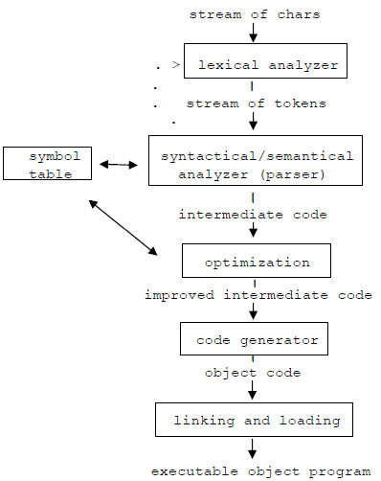
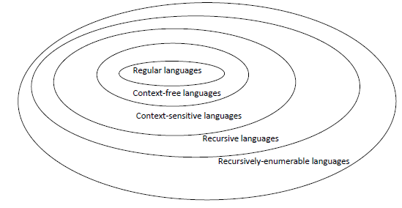
Modeling Languages
Modeling computation
Can problems be solved? (some cannot)
Think abstractly about the method to solve
Modeling languages
Programming language definition, compilation

Slide 4
Definitions
Vocabulary
A set of symbols (V) with terminals, non-terminals, and start symbol
Terminal (T): Cannot be replaced by other symbols
Ex. A, the, rabbit, mathematician, hops, eats, quickly, widely
Non-terminal (N): can be replaced by other symbols
Ex: sentence, noun phase, verb, adjective, article, adverb,
Start symbol (S): we always begin with
Ex: sentence
V*: the set of all words over V. A language over V is a subset of V*
Productions (z₀→ z₁): The rules that specify when we can replace a string with another
Ex: Sentence→ noun phrase verb phrase
Phase-structure grammar G=(V,T,S,P).
Ex: G=(V, T, S, P), where V={a,b,A,B,S}, T ={a,b}, P={S→ABa, A→BB, B→ab, AB→b} where S is the start symbol
L(G): The language generated by G
Ex: V={S,A,a,b}, T={a,b}, and P={S→aA, S→b, A→aa}
What is L(G)? L(G) = {aaa, b}

Slide 5
Grammars (Chomsky Classification)
Type0
Type1
Type2
Type3
Type 0
No restrictions on productions
Recursively-enumerable grammars
Type 1 or Context-sensitive
Productions of the form w1→w2 where w1 = lAr and w2 = lwr where
A is non-terminal
l and r are strings of zero or more terminal or non-terminal symbols
w is non-empty string of terminal or non-terminal symbols. Size of w should be no less than A (Length of w2 is greater that that of w1)
Type 2 or Context-free
Productions of the form w1→w2 where w1 is a single non-terminal symbol
Non-terminal symbol on the lhs can be replaced in a string whenever it occurs
Type 3 or Regular
Productions of the form w1→w2 with w1 =A and w2=aB or w2=a where A and B are not-terminal symbols, and a is terminal symbol
w1 is a single non-terminal, w2 is a terminal or combination of terminal and non-terminal

Slide 6
Exercise
Let G be the grammar with vocabulary, V = {S, 0, 1}, T={0,1}, S is the starting symbol, and productions P={S→11S, S→0}. What is L(G)?
Let G be the grammar with V = {S, 0, 1}, T={0,1}, S is the starting symbol, and productions P={S→0S1, S→λ}, where λ is an empty string
Let G be the grammar with V = {S, 0, 1}, T={0,1}, S is the starting symbol, and productions P={S→0S, S→S1, S→λ}
Let G be the grammar with V = {S, A, 0, 1}, T={0,1}, S is the starting symbol, and productions P={S→0S, S→1A, S→1, A→1A, A→1, S→λ}

Slide 7
Examples
Context-sensitive but not context-free
Context-free but not regular

Slide 8
Examples
Context-sensitive but not context-free
{0^{n}1^{n}2^{n}|n=0,1,2,. . . }. S→C, C→0CAB, S→λ, BA→AB, 0A→01, 1A→11, 1B→12, 2B→22
Context-free but not regular
{0^{n}1^{n}|n=0,1,2,. . . }, S→0S1 and S→λ

Slide 9
Regular expression

Slide 10
Regular Grammar
Review: Type 3 or Regular
Production rules : w1→w2 with w1 =A and w2=aB or w2=a where A and B are not-terminal symbols, and a is terminal symbol
w1 is a single non-terminal, w2 is a terminal or combination of terminal and non-terminal
Regular grammar is the simplest type of grammar.
Commonly used for pattern matching
Rewrite production rules: (w1→ w2)
<non-terminal>::=<terminal> (w2=a)
<non-terminal>::=<terminal><non-terminal> (w2=aB)
<non-terminal>::=λ (w2=λ)
We can generate the same languages using regular expressions

Slide 11

Regular expression
Regular expression over the alphabet ∑ (defined recursively)
Empty string λ
Any character in ∑
Given X and Y are regular expressions, so are
X* means zero or more repetitions of X
Examples
∑ = {+, -, 0, 1}
L1 = {S| S is an unsigned binary number}:
L2 = {S| S is a signed binary number}:
Allow positive numbers with implied sign
| or U
(0|1)(0|1)*
(-|λ)(0|1)(0|1)*

Slide 12
Regular expression (cont.)
∑ = {a, b}
All words contain even number of a’s (i.e., L3 = {S| S has an even number of a’s})
Can it be modeled by (aa|b)* ?
NO
Try
Should be (b|ab*a) *
House keeping
Do I generate all the strings in the language?
Do I generate any string that is not in the language?
Check boundary conditions: e.g., what can it start with/end with
Sometimes drawing Finite Automata helps

Slide 13
Regular expression practice
Let ∑ = {a, b}, write regular expressions for:
All words in which the letter a appears in groups of three (i.e., aaa)
All words containing exactly three b in total
Words baa, ab and abb
Try: All words contain odd number of a’s
b*a(b|ab*a)*

Slide 14
Regular expression for program
Let ∑ = {a, b, c, 1,2 3,_}, write regular expressions for:
C++ identifiers which start with a letter or underscore
(a|b|c|_)(a|b|c|1|2|3|_)*
Ada program identifiers which are restricted from having consecutive underscore characters and must start with a letter
(a|b|c)[(_|λ)(a|b|c|1|2|3)]*(_|λ)
Practice: Rosen 13.4 Exercies #5, #6, #7

Slide 15
Limitations on Regular expression
Let T = {a, b}. Can you find the regular expressions for:
a^{n}b^{n}, n >= 0 ?
No
How about the regular expression for strings with an even numbers of a’s? where T={a,b,c}
((b|c)*a(b|c)*a (b|c)*) *

Slide 16
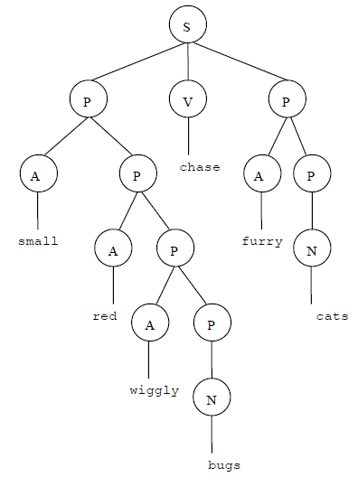

Context-free (CF) Grammar
All programming languages are CF languages, can be defined by CF grammar
Derivation tree: parse tree where root is a starting symbol, internal vertices are non-terminal, leaves are terminal
CF grammar example
If interested, may (optionally) read Optional- ContextFreeGrammar.pdf at Files/additionalMaterials

Slide 17
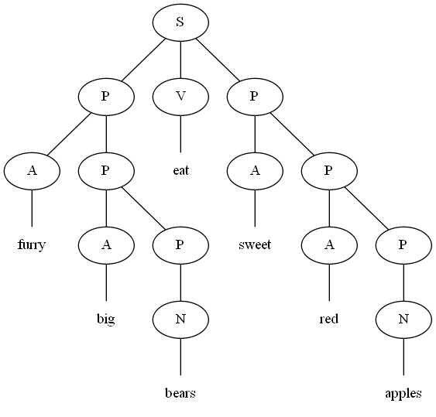
CF Grammar Example
Derivation (A: adjective P: phrase N: noun S: sentence V: verb)
S→P V P (P → AP) Turning parents into leaves
S → A P V P (P → AP)
S → A A P V P (P → N)
S → A A N V P (P → AP)
S → A A N V A P (P → AP)
S → A A N V A A P (P → AP)
S → A A N V A A N (P → N)
Phrase: “furry big bears eat sweet red apples”

Slide 18
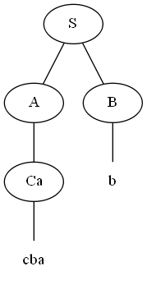
Parsing
Determine whether “cbab” belongs to L(G), where G=(V,T,S,P), and V={a,b,c,A,B,C,S}, T={a,b,c}, P={S→AB, A→Ca, B→Ba, B→Cb, B→b, C→cb, C→b}
Top-down parsing:
S→AB (A→Ca)
→CaB (C→cb)
→ cbaB (B→b)
→ cbab
Bottom-up parsing:
cbab← Cab (cb←C)
← Ab (Ca ←A)
← AB (b← B)
← S

